Slide 1
PROJECT 2
Housing Price
Prediction
Using Ridge & Lasso Regression
to predict Ames, Iowa home sale prices
Abraham De Vargas
2,637
81
RMSPE
Deep Dive Data Science · Cohort-20
04/17/2026
Home Sales
Features
Performance Metric
Notes:
Welcome everyone. This is Project 2 from the Deep Dive Data Science cohort — a linear regression model to predict housing prices using the Ames, Iowa dataset. The dataset has 2,637 home sales and 81 features. Our primary performance metric is RMSPE — Root Mean Squared Percentage Error — which I'll explain in a moment. My name is Abraham De Vargas, and today I'll walk you through the full pipeline from data cleaning to our final recommended model.

Slide 2
What We'll Cover
01
02
03
04
The Problem
The Data
Models & Results
Key Takeaway
Predict home sale prices in Ames, Iowa
2,637 homes · 81 features · AWS S3
Ridge, Lasso & Lean Ridge · RMSPE metric
Fewer features → better performance
Abraham De Vargas · Deep Dive Data Science Cohort-20 · 04/04/2026 · Agenda
Notes:
Here's a quick roadmap for the presentation. We'll cover four main areas: the business problem and why it matters, the data and how we cleaned it, the models we built and their results, and finally the key takeaway about feature selection. The presentation follows the same structure as the notebook, so if you want to follow along with the code, each section maps directly.

Slide 3
The Problem
What will this house sell for?
2,637
L1 / L2
Supervised Regression Problem
Predict a continuous dollar value — not a category
home sales
regularization
Target: SalePrice
Continuous numeric value — the known outcome label
81
100x
Metric: RMSPE
$20k error on a $100k home (20%) ≠ $20k on a $500k home (4%)
features
CV iterations
~80 Features
Size, quality, age, neighborhood, garage, basement, and more
RMSPE
log1p
Models Used
Linear Regression, Ridge (L2), Lasso (L1), Lean Ridge
performance
metric
target transform
Abraham De Vargas · Deep Dive Data Science Cohort-20 · 04/04/2026 · Problem Definition
Notes:
The core question here is: given what we know about a house, what will it sell for? This is a supervised regression problem — we have labeled examples with known sale prices, and we're learning a function to predict price from features. I chose RMSPE as the metric because it's proportional — a $20k error on a $100k home is a 20% miss, while the same dollar error on a $500k home is only 4%. Plain RMSE would treat those identically, which doesn't reflect real-world impact. The dataset has roughly 80 features covering everything from square footage and neighborhood to garage size and basement quality.

Slide 4
Data & Cleaning
Ames Housing Dataset — Ames, Iowa residential sales · Hosted on AWS S3
DROPPED
IMPUTED
ENCODED
4 columns
0 nulls remain
263 features
PID (ID column)
Categorical nulls → 'None'
One-hot encoding of all
Pool QC, Misc Feature, Alley
(no garage = no garage,
object columns
(all >80% null)
not missing data)
drop_first=True avoids
Numeric nulls → column median
dummy variable trap
Final cleaned shape: 2,637 rows × 77 columns → 263 encoded features after one-hot encoding
Abraham De Vargas · Deep Dive Data Science Cohort-20 · 04/04/2026 · Data Collection & Cleaning
Notes:
Data cleaning had three main decisions. First, I dropped columns with over 80% null values — Pool QC, Misc Feature, and Alley. Imputing that much data would essentially be making it up. Second, for categorical nulls like Garage Type or Fireplace Quality, a null actually means the feature doesn't exist — no garage, no fireplace — so I filled those with the string 'None' to preserve that meaning as its own category. For numeric nulls, I used the column median rather than the mean, because housing prices are right-skewed and the mean gets pulled up by expensive outliers. After one-hot encoding all the categorical columns, we went from 77 features to 263. No duplicates were found.

Slide 5
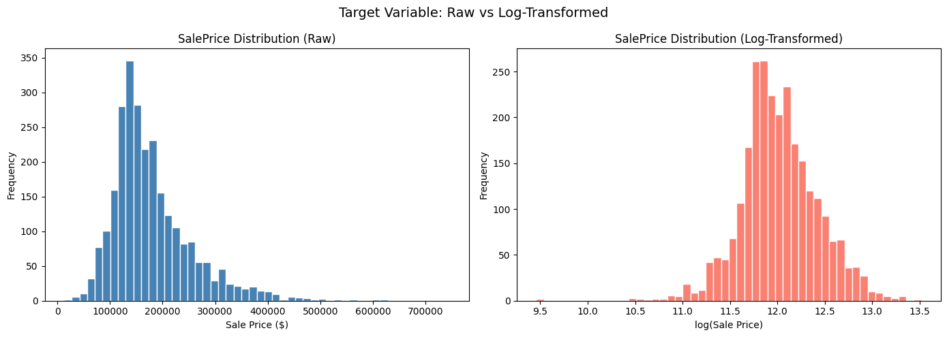
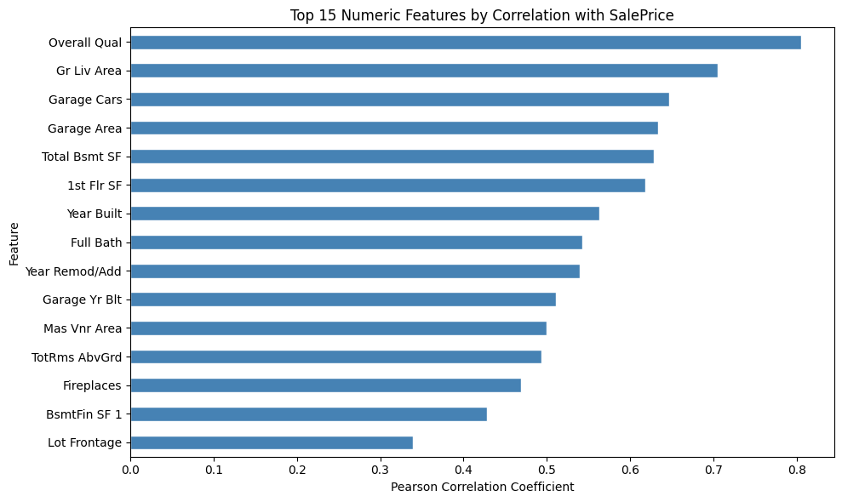
Exploratory Data Analysis
SalePrice Distribution
Top Correlations with SalePrice
Raw vs Log-Transformed SalePrice histogram
Top 15 features correlation bar chart
→ Right-skewed: log transform applied before modeling
⚠ Multicollinearity between top predictors (Garage Cars ↔ Garage Area) — reason for Ridge/Lasso
Abraham De Vargas · Deep Dive Data Science Cohort-20 · 04/04/2026 · EDA
Notes:
Two key EDA findings shaped the modeling decisions. First, SalePrice is clearly right-skewed — a long tail of expensive homes pulls the distribution right. Log-transforming it makes it much more symmetric, which is better for linear regression. Second, the correlation heatmap revealed multicollinearity among the top predictors — for example, Garage Cars and Garage Area are both correlated with price AND with each other. This is one of the reasons regularization is important here. The top predictors by correlation are Overall Quality, above-ground living area, garage capacity, and basement square footage — all very intuitive.

Slide 6
Modeling Approach
1
2
3
4
5
→
→
→
→
Log Transform
Scale Features
100-Fold CV
3 Models
Lean Model
log1p(SalePrice)
optimizes for % error
StandardScaler
(inside CV loop)
Stable RMSPE
estimate
OLS · Ridge · Lasso
Lasso selects
min features
Why log transform?
Fitting on log(SalePrice) naturally minimizes proportional errors — converts back with exp() before scoring
Why regularization?
263 features after encoding = high overfitting risk. Ridge shrinks all coefficients; Lasso zeros low-signal ones out entirely
Abraham De Vargas · Deep Dive Data Science Cohort-20 · 04/04/2026 · Processing
Notes:
The modeling pipeline has five steps. One: log-transform SalePrice before training so we're optimizing for proportional errors. Two: scale features using StandardScaler — this is required for Ridge and Lasso so large-scale features like square footage don't dominate the regularization penalty. Critically, the scaler is fit inside the CV loop on training data only — fitting it on the full dataset before splitting would be data leakage. Three: run 100 iterations of train/test splitting to get a stable RMSPE estimate — a single split can be misleading. Four: evaluate three models — plain linear regression, Ridge with L2 regularization, and Lasso with L1. Five: use Lasso's property of zeroing out coefficients as automatic feature selection to build a lean model.

Slide 7
Results — RMSPE Comparison
Model
Mean RMSPE
Features
0.1451
177/262
Linear Regression
0.1619
262
Lean Ridge RMSPE
Best Model
features used
85 dropped
Ridge (alpha=10)
0.1503
262
Lasso (alpha=0.001)
0.1485
262
$19,360
★ Lean Ridge (recommended)
0.1451
177
avg $ error (RMSE)
on held-out test set
Key Finding: The Lean Ridge model — using only Lasso-selected features — outperformed all full-feature models. Dropping 85 low-signal features improved RMSPE from 0.1503 → 0.1451 (~14.5% avg error), directly meeting the project goal of a minimum feature set that does the job.
Abraham De Vargas · Deep Dive Data Science Cohort-20 · 04/04/2026 · Results
Notes:
Here are the results. Plain linear regression gets 0.1619 mean RMSPE. Ridge improves that to 0.1503, and Lasso is slightly better at 0.1485. But the standout result is the Lean Ridge model — after using Lasso to drop 85 low-signal features, retraining Ridge on the remaining 177 features gives us 0.1451. That's a 3.5% improvement over full Ridge while using 32% fewer features. On a single held-out test set, the final Ridge model has an RMSE of $19,360 — meaning on average, predictions are within about $19k of the true price. The Lean Ridge is the recommended model because it's both more accurate and more interpretable. One thing worth noting — removing just 2 outlier homes, large properties with anomalously low sale prices that were likely non-market transactions, had a noticeable effect on model performance. It's a good reminder that a small amount of data cleaning can matter more than model choice.

Slide 8
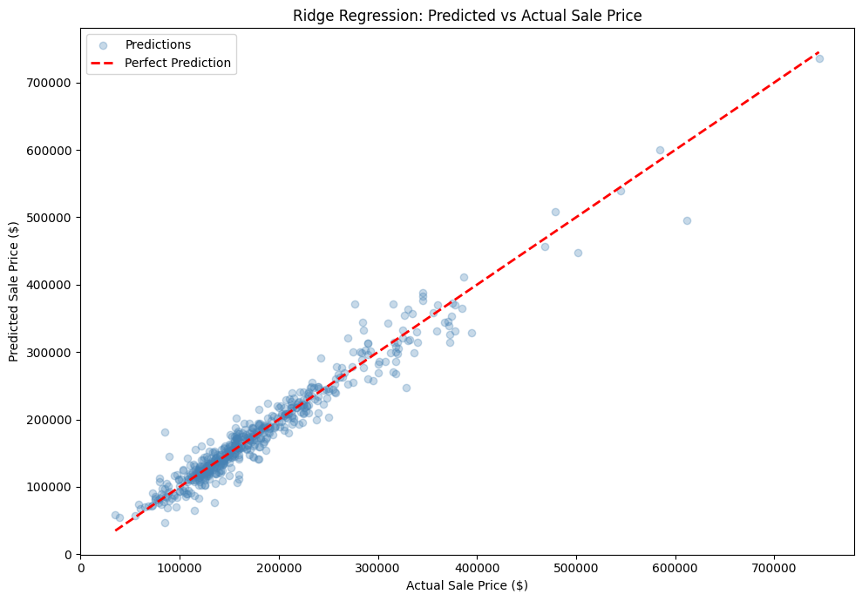
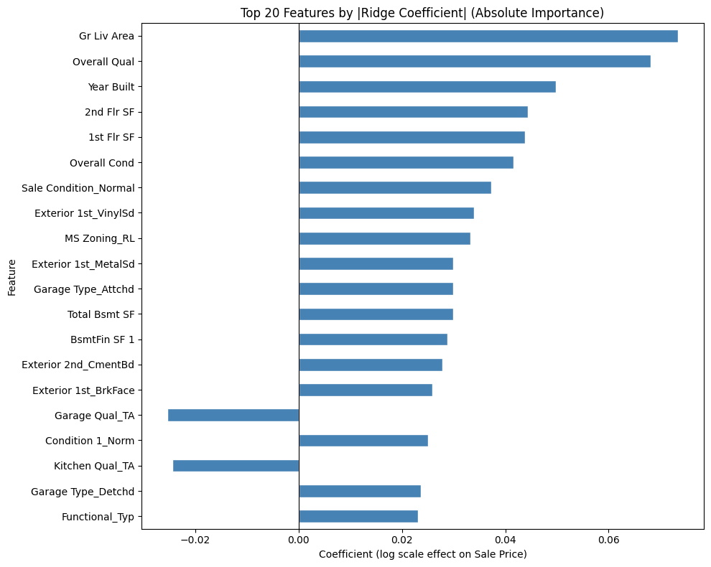
Model Diagnostics
Predicted vs Actual Sale Price
Top Features by Ridge Coefficient
[ Insert Graph Here ]
[ Insert Graph Here ]
Predicted vs Actual scatter plot (Ridge)
Top 20 Ridge coefficient bar chart
Points cluster tightly along the diagonal — especially in the $100k–$300k range. Spread widens at higher prices (typical for linear models).
Roof material, Overall Quality & living area are the top drivers — fully consistent with real-world real estate intuition.
Abraham De Vargas · Deep Dive Data Science Cohort-20 · 04/04/2026 · Visualization
Notes:
The predicted vs actual plot shows points clustering tightly along the diagonal — especially in the moderate price range of $100k to $300k. The spread increases at higher prices, which is typical for linear models on skewed targets. Predictions at the very high end are less reliable. The residuals plot is generally centered around zero with no strong pattern, meaning there's no systematic over- or under-prediction. There's some heteroscedasticity — wider spread at higher prices — which could be addressed with more advanced models. The top features by Ridge coefficient include Overall Quality, living area, and roof material type. The neighborhood and sale condition features also appear, which aligns with real-world real estate intuition.

Slide 9
Summary & What's Next
Key Takeaways
What's Next
Lean Ridge (177 features) beats full model (262 features) — 0.1451 vs 0.1503 RMSPE (~14.5% avg error)
Gradient Boosting / XGBoost — capture non-linear effects
Lasso is a powerful automatic feature selector
Feature engineering — house age, total bathrooms
Log-transforming the target is critical for % error optimization
GridSearchCV to tune regularization alpha
Feature scaling must happen inside CV to avoid data leakage
Remove price outliers (large homes, anomalous sales)
Overall Quality & living area are the strongest price drivers
Evaluate with additional metrics (R², MAE)
Questions?
Abraham De Vargas · Deep Dive Data Science Cohort-20 · 04/04/2026 · Conclusion
Notes:
To summarize: the Lean Ridge model using 177 Lasso-selected features outperformed every full-feature model. The key lessons are: log-transforming the target is critical for optimizing percentage error; feature scaling must happen inside the CV loop to avoid leakage; and Lasso is a powerful automatic feature selector that actually improved performance by removing noise. For future work, I'd want to try gradient boosting models like XGBoost, which can capture non-linear interactions that linear regression misses, tune the regularization alpha with GridSearchCV, and engineer new features like house age and total bathroom count. I'm happy to take any questions.

